Slide 1
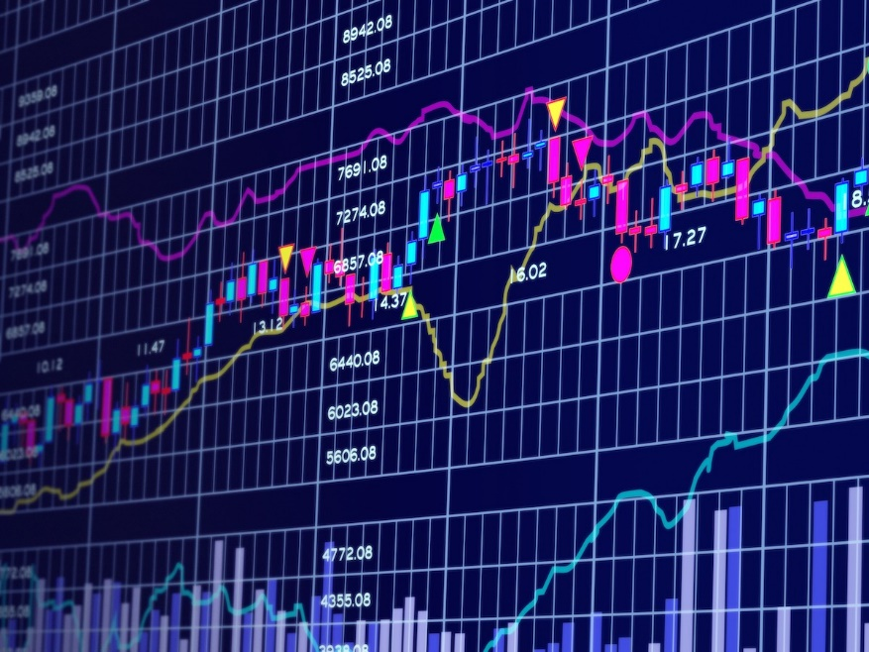
Stock Price Prediction Using Machine Learning Algorithm.
By: Kelvin Oyanna
Email: dotkelplus@gmail.com
Twitter: @KelvinOyanna
Call: 08036467038

Slide 2


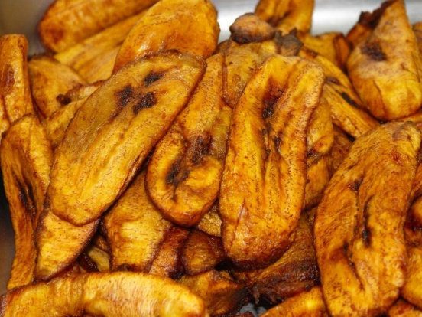
About Me
I’m a data scientist with core interest in data analytics technology, Machine Learning and Artificial intelligence.
I love building tech communities. I’m currently the Co-organizer & team lead for Pydata Lagos.
I love Fried plantain - Dodo

Slide 3
What is a stock?
Stocks also referred to as shares or equity represents a fractional ownership in a company.

Slide 4
What is the stock market?
The stock market refers to public markets that exist for issuing, buying and selling stocks that trade on a stock exchange or over-the-counter.
Simply put, the stock market is a place where investors can sell or buy ownership of companies in the form of stocks or shares.

Slide 5
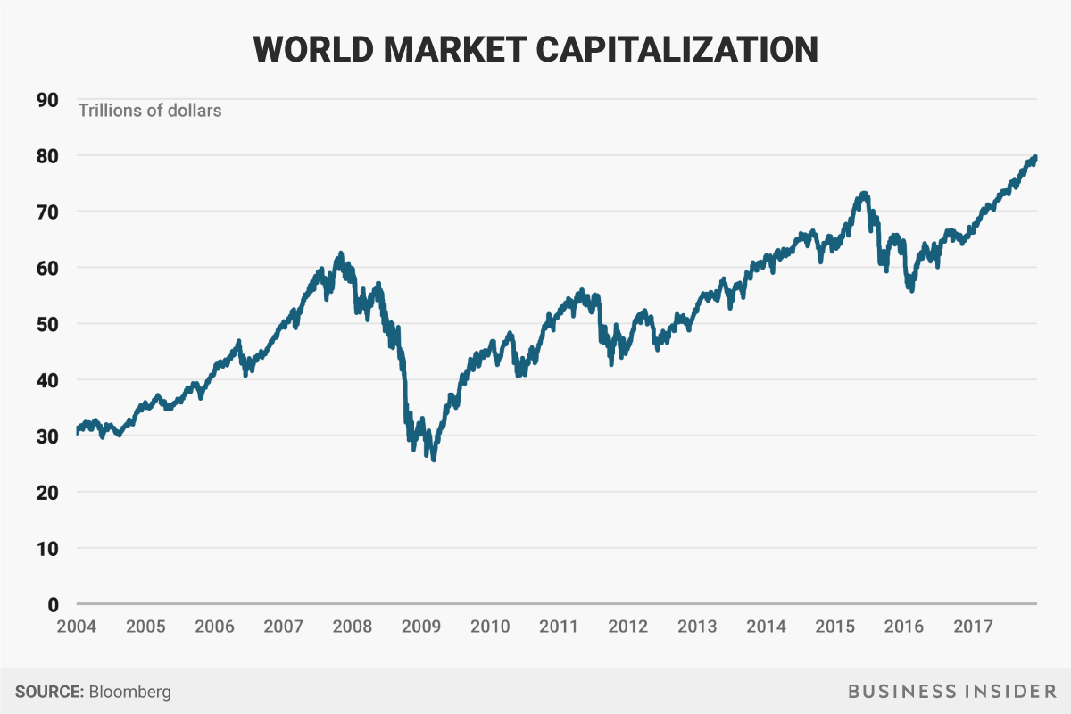
What’s the fuss about the Stock Market?
Global Market Capitalization= $80 Trillion.
Heading steadily towards $100 Trillion

Slide 6
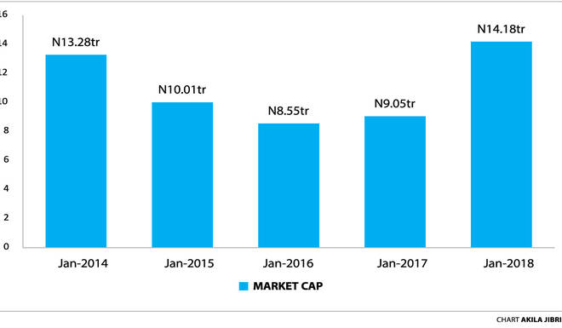
Nigeria Stock Exchange (NSE)
The Market Capitalization of NSE as at January 2018 stood at N14.18 Trillion.

Slide 7

Why Stock Price Prediction?

Slide 8

Me after Investing in Stock
Grab some popcorn
&
Watch my money grow like grass.

Slide 9

Me after seeing my investment yield after 3 months

Slide 10

Me seeing my investment yield after 1 year.

Slide 11
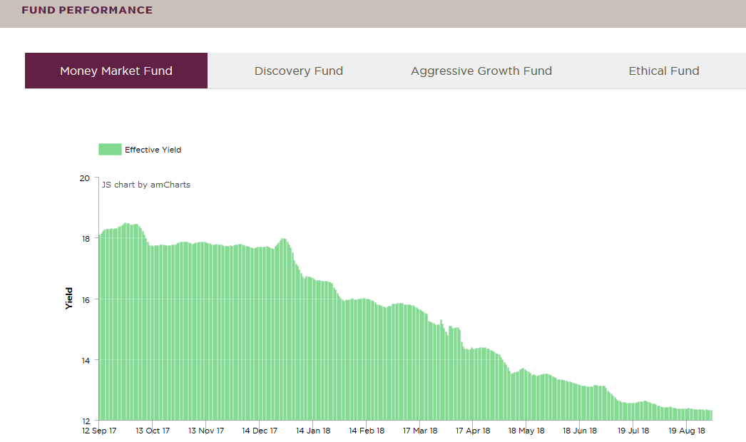
Here is what happened:

Slide 12

Think About this:

Slide 13
What if I understand all the underlying factors that influence the prices of stocks so I can purchase stocks that will yield better return?

Slide 14
What if I can build an automated trading system that can understand these factors, accurately predict future prices of stocks and tell me which stock is safe/profitable to buy?

Slide 15

Your guess is as good as mine:

Slide 16
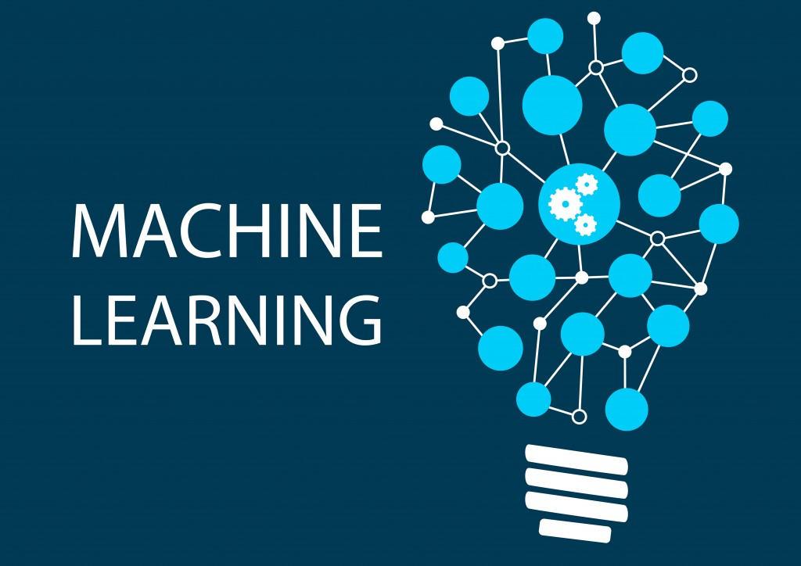
Machine Learning to the rescue!

Slide 17
“Machine Learning at its most basic is the practice of using algorithms to parse data, learn from it, and then make a determination or prediction about something in the world.”
- Nvidia

Slide 18
Let’s dive into implementing a Machine Learning Algorithm to predict stock prices…

Slide 19
Our goal is to build a Machine Learning Model to predict stock prices.
The Goal:

Slide 20
Outcome:
The outcome of our work will be predicted prices & a measure of the percentage of accuracy of our model in predicting the prices.

Slide 21
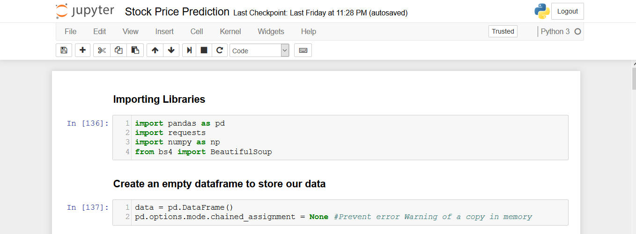

Slide 22
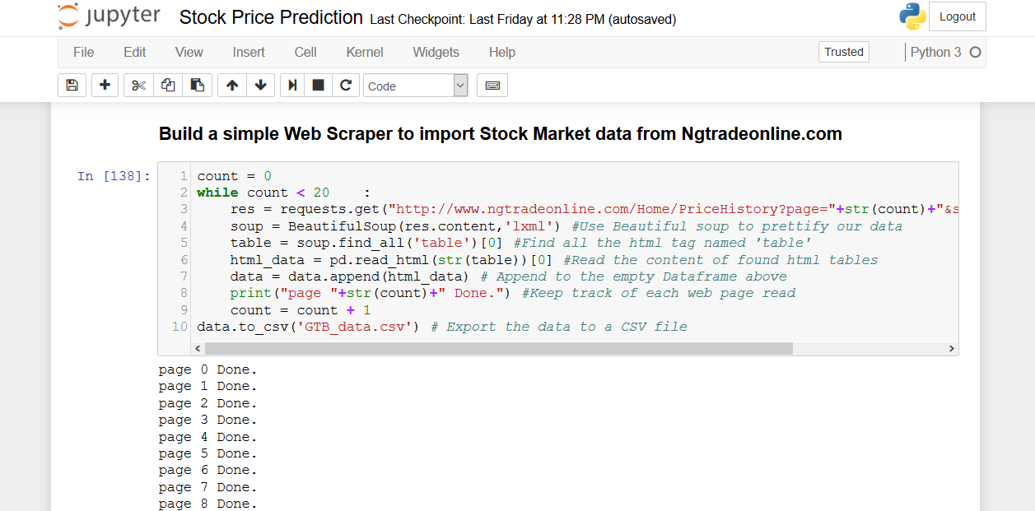

Slide 23
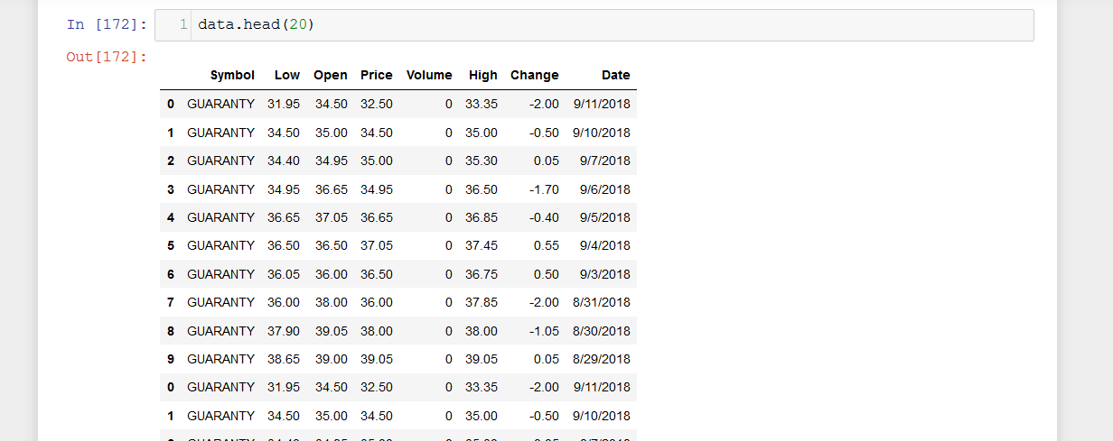
Let’s look at the Data

Slide 24
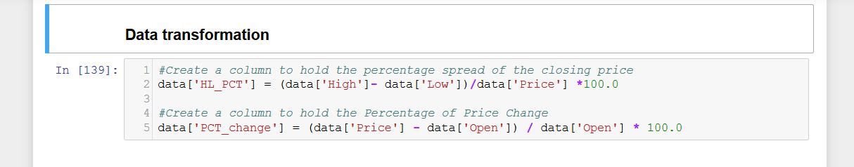

Slide 25
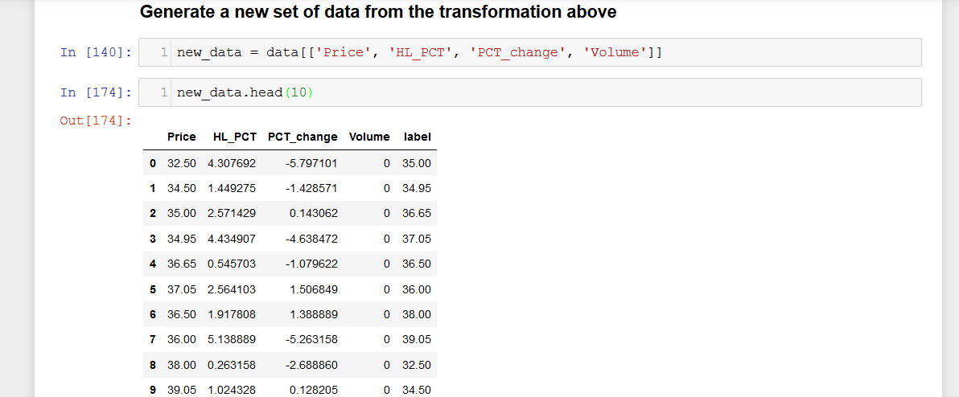

Slide 26
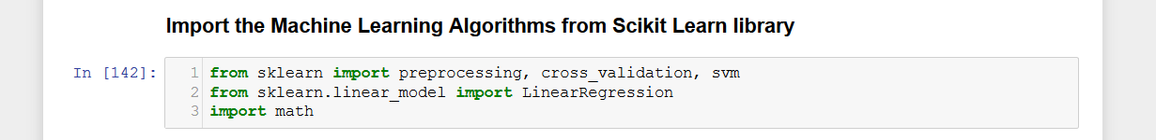
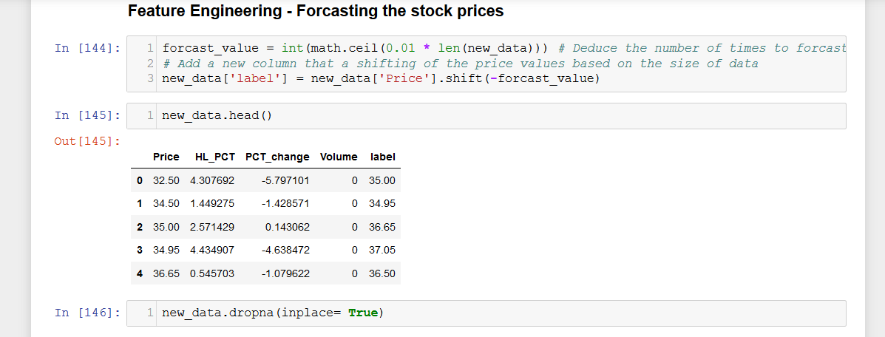

Slide 27
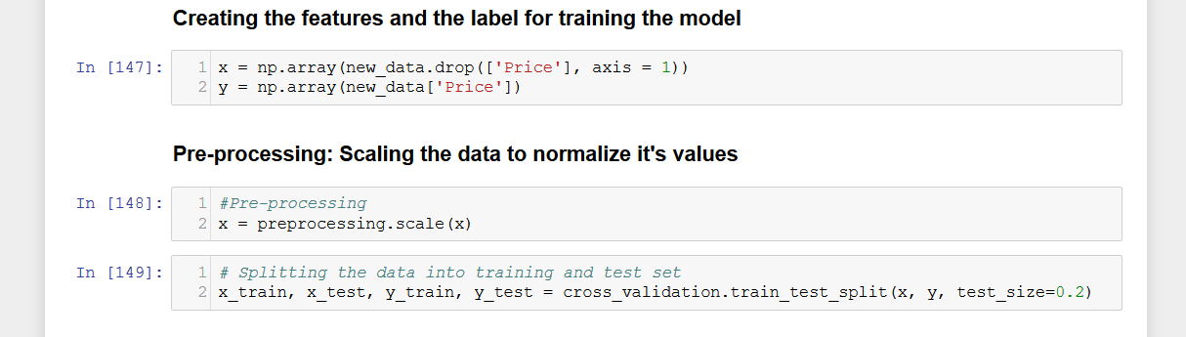

Slide 28
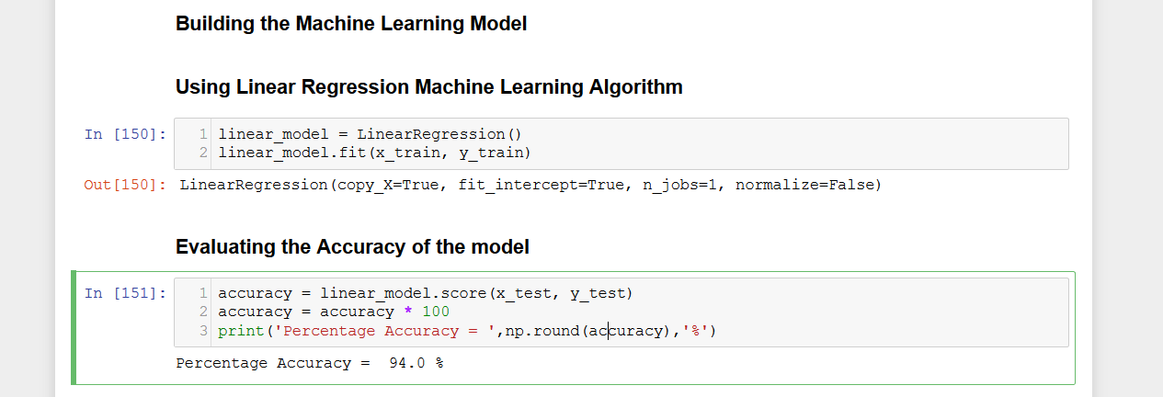

Slide 29
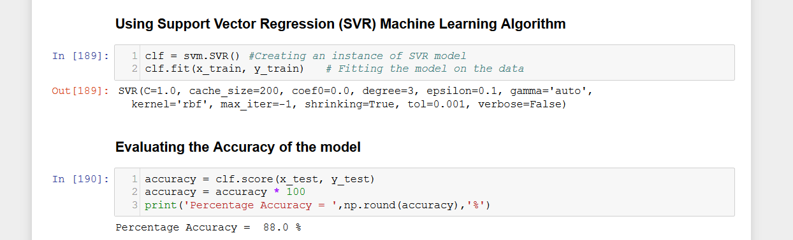

Slide 30
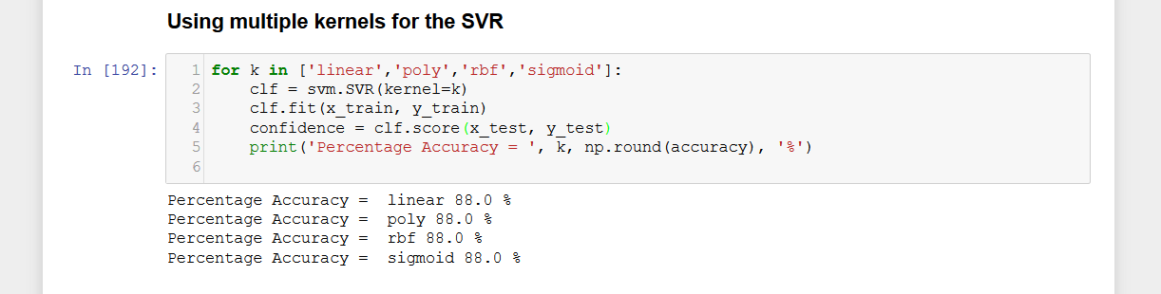

Slide 31
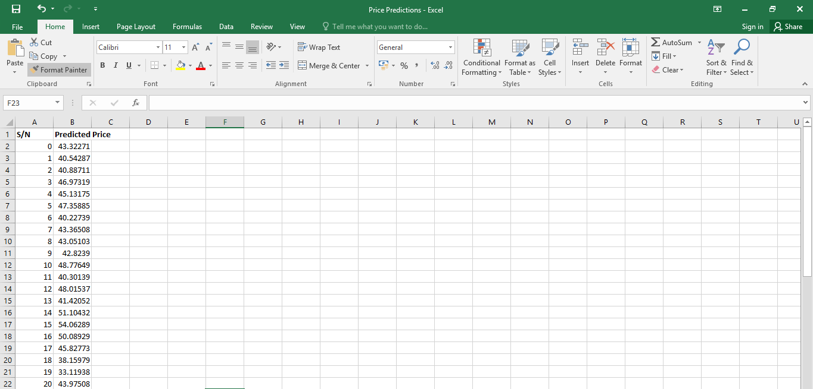

Slide 32
Conclusion
This model can be deployed as a web service on an automated trading platform.

Slide 33

Got Questions?

Slide 34
Thank you!

